Slide 1

MOTIHARI COLLEGE OF ENGINEERING,MOTIHARI
Department of Computer Science & Engineering
Project Presentation
HATE SPEECH RECOGNITION
Guided by:- Mr. Krishna Karak(Assistant Professor)
Co Guided by:- Kunal Maurya
Submitted by:-
S.No. | Name | Reg. No.
1. | Abhishek Kumar | 21105113026
2. | Md Ahteshamul Haque | 21105113031
3. | Saif Ali Khan | 21105113018
4. | Suman Kumari | 21105113049

Slide 2
OVERVIEW:-
Introduction
Objective
Problem statement
Methodology
Conclusion
Future Work

Slide 3
INTRODUCTION:-
Hate speech is defined as communication that incites hatred, intolerance, or violence against individuals or groups based on characteristics such as race, religion, ethnicity, nationality, gender, sexual orientation, or disability.
This type of speech can take many forms, including verbal, written, or symbolic expressions, and can have serious consequences, including emotional harm, social divisions, and even violence.
Importance:-
The importance of hate speech recognition:
Promotes online safety
Fosters inclusive communities
Improves content moderation
Reduces harm and violence

Slide 4
PROBLEM STATEMENT:
Rapid increase in online hate speech across social media and digital platforms.
Manual moderation is time-consuming, inconsistent, and not scalable.
Build a machine learning model to identify offensive, abusive, or discriminatory
language.
Enhance online safety and support effective content moderation.

Slide 5
OBJECTIVES:-
Identify and Flag Hate Speech: Accurately identify and flag hate speech content to prevent its spread.
Reduce Harm: Reduce the harm caused by hate speech to individuals, communities, and society.
Promote Online Safety: Promote online safety and respect for diverse perspectives and opinions.
Improve Content Moderation: Improve content moderation practices on social media platforms, online forums, and other digital spaces.
Enhance User Experience: Enhance user experience by reducing exposure to hate speech and promoting a positive online environment.

Slide 6
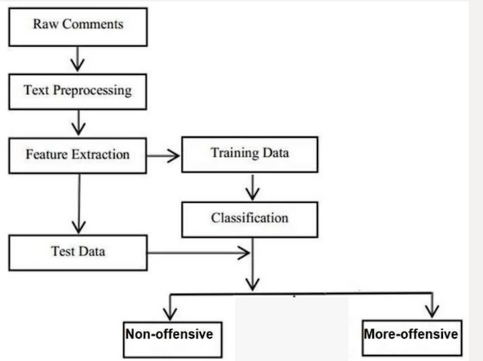
METHODOLOGY:-
Rule-based: Uses predefined rules to identify hate speech.
Machine learning: Trains models on labeled datasets to recognize hate speech.
Hybrid: Combines multiple approaches for improved accuracy.

Slide 7
DATASET AND PREPROCESSING:-
Data Collection:
Social Media Platforms: Collect data from social media platforms (Twitter, Facebook, etc.).
Online Forums: Collect data from online forums and discussion boards.
Hate Speech Datasets: Utilize existing hate speech datasets (e.g., Hatebase, Toxic Comment Classification Challenge).
Preprocessing:
Tokenization: Split text into individual words or tokens.
Stopword Removal: Remove common words (e.g., "the", "and") that do not add meaning.
Stemming or Lemmatization: Reduce words to their base form.

Slide 8
FEATURE EXTRACTION TECHNIQUES:-
Bag-of-Words (BoW): Represents text as a bag of words, ignoring grammar and word order.
Term Frequency-Inverse Document Frequency (TF-IDF): Weights words based on frequency and rarity in the corpus.
Word Embeddings (e.g., Word2Vec, GloVe): Maps words to vectors in a high-dimensional space, capturing semantic relationships.
Sentiment Analysis: Extracts sentiment scores from text, indicating positivity, negativity, or neutrality.
Named Entity Recognition (NER): Identifies named entities (e.g., people, organizations, locations) in text.

Slide 9
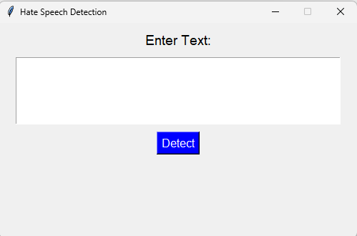
USER INTERFACE

Slide 10
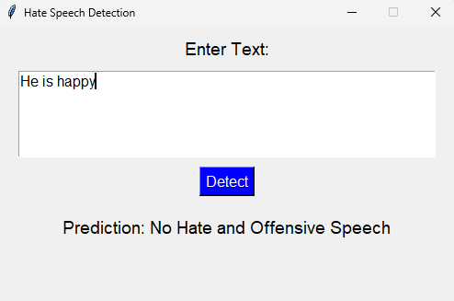
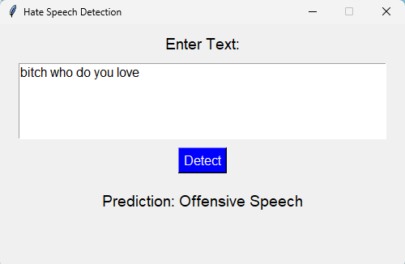
OUTPUT

Slide 11
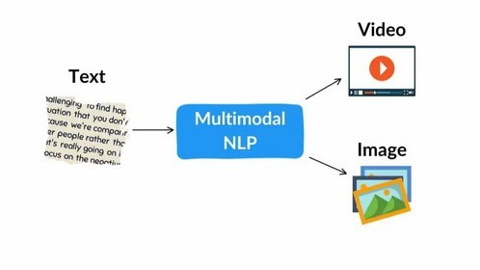
CONCLUSION:-
Hate speech recognition is a growing field
Deep learning and transformer models outperform older methods
Datasets and context understanding remain critical
Future directions: explainability, fairness, multilingual support
FUTURE WORK:-
Multimodal Data
Feature Engineering
Interdisciplinary Approach
User Feedback Integration

Slide 12
THANK
YOU

